Slide 1

GESTURE INTERPRETATION FOR HOME AUTOMATION
By:
SHUBDEEP GAUTAM RA1811003010273
MRETUL MADAV RA1811003010278
ANOUSHKA HALDER RA1811003010283
ADYASHA PATTANAIK RA1811003010293
RAGHU B RA1811003010303

Slide 2
Outline
Introduction
Why home automation?
Revelation
Application
What is gesture?
Gesture Recognition
Algorithms
Home automation protocols

Slide 3
INTRODUCTION:
Homes of the 21st century will become more and more self-
controlled and automated. Simple devices such as a timer to turn on
one's coffee maker in the morning have been around for many years,
but much more sophisticated mechanisms will soon be prevalent in
homes around the world.
Imagine walking into your home and being greeted at the door
with lights illuminating your path without you ever having to touch
light switch, with your favourite music streaming through the
speakers in whichever room you enter (because your home
recognized that it was you and not some other household member),
all while having the peace of mind knowing that your home
automation system took care of activatis your security system.
Furthermore, such a system could allow the user to schedule events
to occur at recurring intervals (e.g., tum on sprinkler system at
4:30a.m. every Tuesday and Thursday).

Slide 4
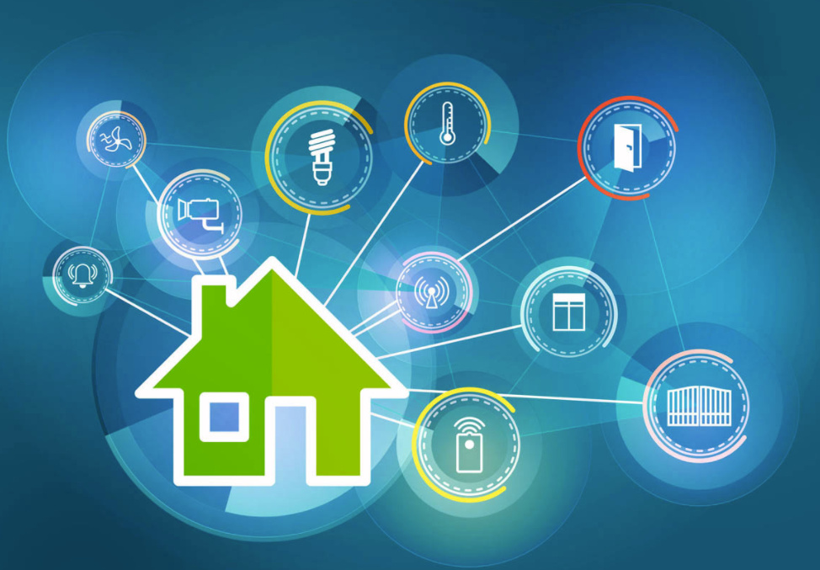
Why home automation?
Home automation means using technology to automate or remotely control various household functions. For example, the operation of lighting, heating or entertainment devices.
The benefits of home automation typically fall into a few categories
savings
Safety
Convenience
control.

Slide 5
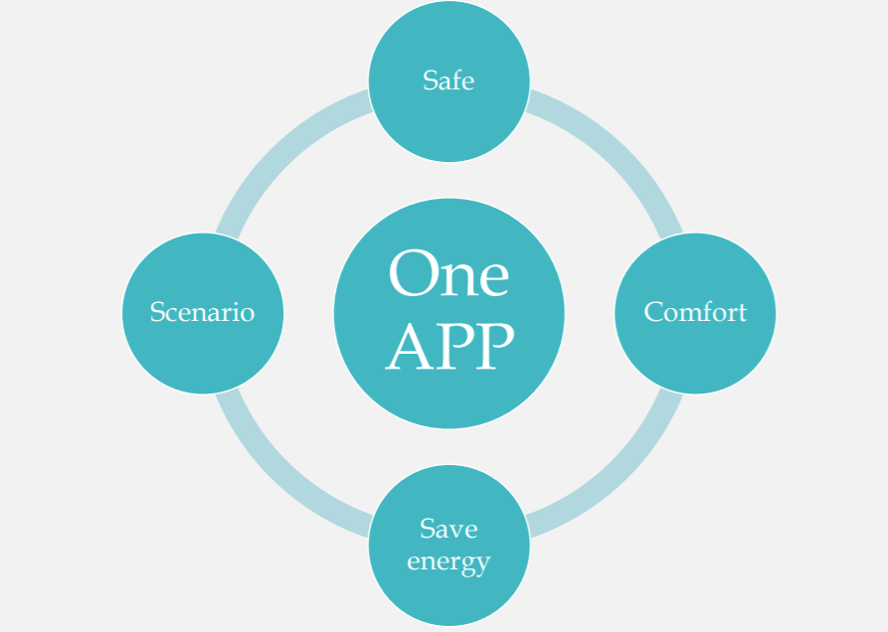
Revelation

Slide 6
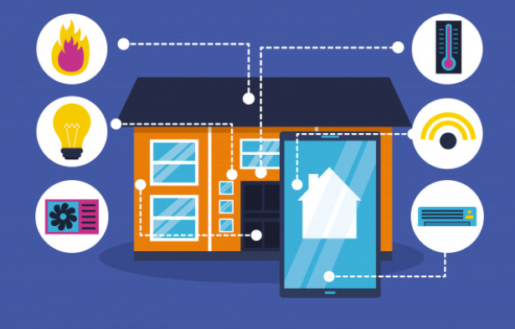
APPLICATIONS:
The applications are limited only by your imagination
Turning lights down / off at night.
Operating outside lights
Turning lights or radio on / off when someone approaches the house, simulating occupancy
Operating television, hot water heater, kettle, toaster etc. ready for your use.
Optimizing use of low cost electricity (economy)
Working with intelligent electrical white goods e.g. washing machine, fridge, microwave etc.

Slide 7
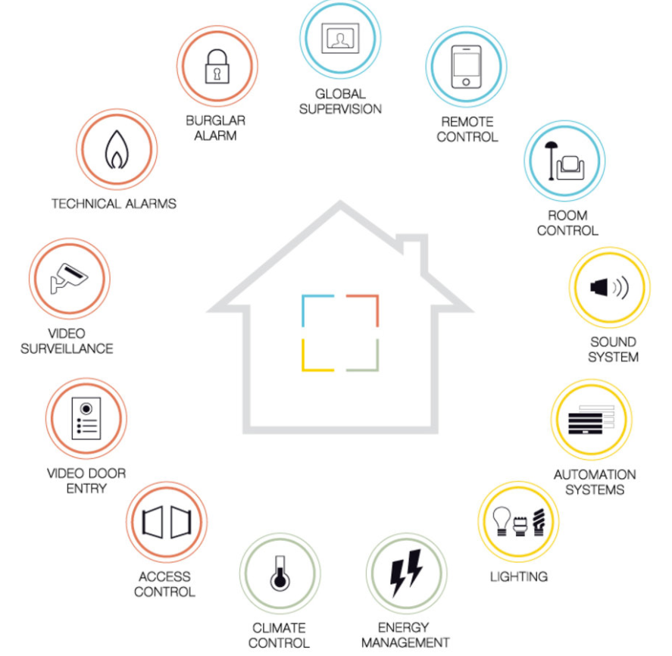

Slide 8
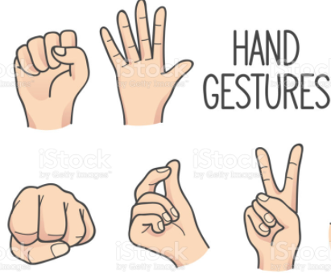
What is gesture?
A gesture is a form of non-verbal communication or non-vocal communication in which visible bodily actions communicate particular messages, either in place of, or in conjunction with, speech. Gestures include movement of the hands, face, or other parts of the body. Gestures differ from physical non-verbal communication that does not communicate specific messages, such as purely expressive displays, proxemics, or displays of joint attention. Gestures allow individuals to communicate a variety of feelings and thoughts, from contempt and hostility to approval and affection,

Slide 9
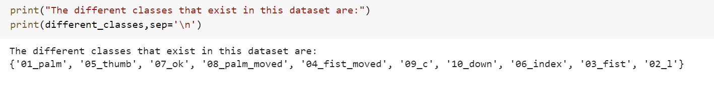
Gesture Recognition
Gesture recognition is a topic in computer science and language technology with the goal of interpreting human gestures via mathematical algorithms. It is a subdiscipline of computer vision. Gestures can originate from any bodily motion or state but commonly originate from the face or hand.
Here the posible gesture are recognised and in future assigned a task.

Slide 10

Home automation protocols.
KNX.
C-Bus system.
ZigBee. Zwave .
Other protocol .

Slide 11
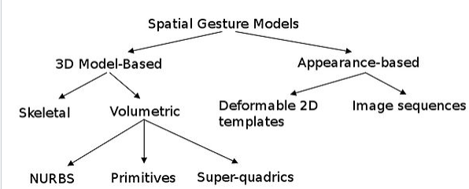
Algorithms

Slide 12
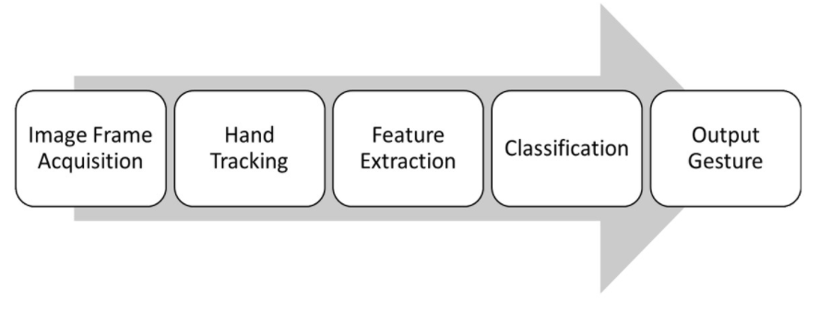
Basic steps:

